Slide 1
Introduction To F#
Hampton Roads User Group
July 2016
Jamie Dixon

Slide 2
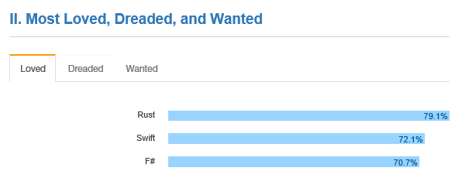

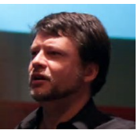
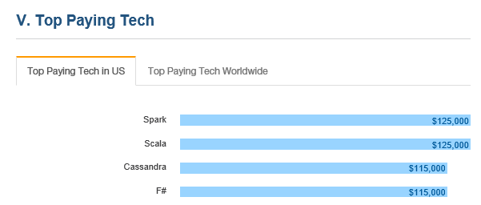
Why you should care?
Notes:
your next language should be F# - Uncle Bob Martin
you need to think differently - F# is a great choice - Andy Hunt
Make more money - stack overflow
Have more fun - me

Slide 3



Learning a new language is hard
Actual Silverlight Development
Notes:
javascript was good idea
Is it worth the pain?
Will I write better code?
Will I be faster to market?
What if people use it as an excuse for failure? What if Microsoft pulls the plug?

Slide 4
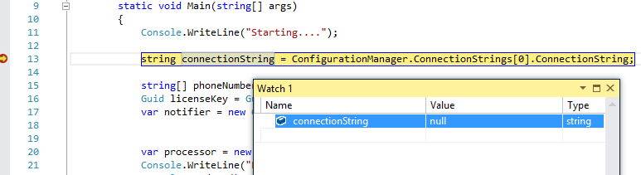



Your Most Common Bugs
Improper state
Null Ref is the Million Billion dollar bug
Premature optimization
Broken Dependencies
Changes to database schemas
Changes to your code
External libraries
Environmental Factors
Traffic
CPU usage
Notes:
improper state (null ref)
broken dependencies database schema != domain model (object impediance)
environmental factors

Slide 5
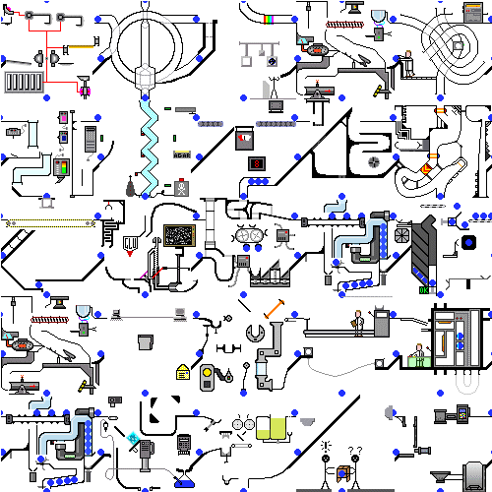


Top Reasons For Bugs
Notes:
Time pressures
Changing requirements
Complexity of software

Slide 6

Can your language help?
You will write less, more meaningful code
You will write code faster
You will be more correct
You will have more fun
Examples:
Illegal State
System Complexity

Slide 7
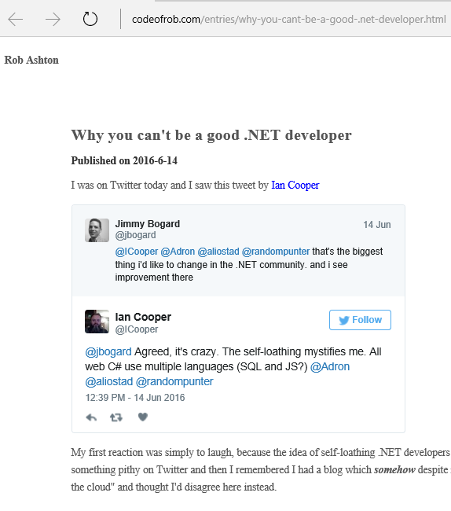
Is It The Fate of .NET?
There is a reason this mentality exists and it isn't one of self loathing. The reason why people "leave" .NET is because it is impossible to be a good .NET developer. To work in a development shop with a team is to continually cater for the lowest common denominator of that team and the vast majority of software shops using .NET have a whole lot of lowest common denominator to choose their bad development decisions for.

Slide 8





What about Microsoft?
They care about selling … OS, MSDN (incl VS), Azure Time
Moving from C# to F# does not do that
C#/F# are not considered gateways anymore
Microsoft created some great things… that died
Microsoft created some dumb things… that survive

Slide 9

What About You? And Your Company?
F# is the lowest risk way to learn functional programming
F# is the lowest risk way to solve your current programming headaches
Example…

Slide 10
Questions
https://github.com/jamessdixon/hrug.mainmeeting.july2016
jamessdixon@gmail.com
@jamie_Dixon
http://fsharp.org/

